Slide 1
The Art of 64-Bit Assembly
Using MASM

Slide 2
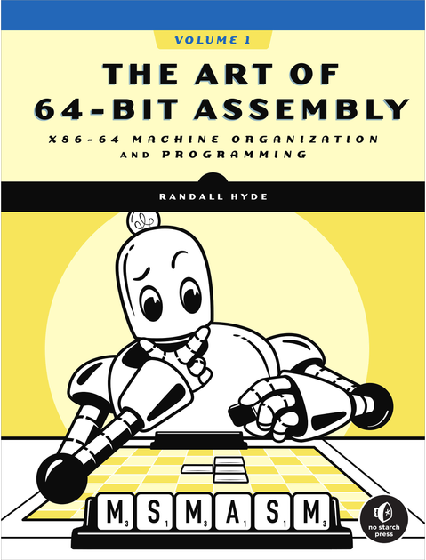
Reference Materials
Textbook: The Art of 64-Bit Assembly by Randal Hyde
ISBN: 978-1-7185-0108-9
https://artofasm.randallhyde.com/

Slide 3
X86-64 Basics
Pg 9 - 17

Slide 4
Von Neuman Architecture
Memory
x86-64 CPU Family utilizes a Von Neuman Architecture
The Von Neuman Architecture is composed of 3 components:
I/O Device
CPU
Memory
I/O (input/output) devices is any hardware used for the user to interact with the OS.
Ex. keyboard, mouse, display, ect.
Figure 1-1: Von Neumann computer system block diagram

Slide 5
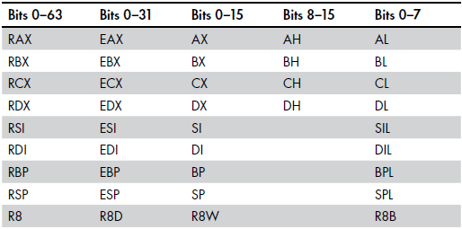
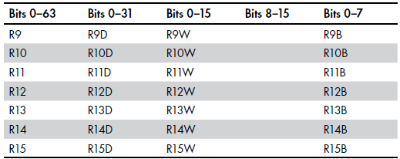
CPU & Registers
A CPU is responsible for OS computation (like a brain)
Registers are located within the CPU and allow it to compute by (quickly) storing information for the CPU to calculate
There are Four categories of registers:
Segment
General purpose
Special purpose applications accessible
Special purpose kernel-console
General purpose registers are NOT INDEPENDENT of one another!!!
Value Corruption: an error caused when a modified register disrupts the existing value of registers
Ex. modifying the EAX register can alter the AL, AH, AX, & RAX registers
Table 1-1: General-Purpose Registers on the x86-64
Notes:
1. Segment -- not used in modern 64bit OS
2. General Purpose –
3. Special Purpose App… -- ?????
4. Special Purpose Ker... -- system-level tools (OS, debugging)
*This course will focus on General Purpose & Special Purpose App…

Slide 6
Special Purpose Registers (SKIP)
A CPU is responsible for OS computation (like a brain)

Slide 7
CPU & RFLAGS (SKIP)
A CPU is responsible for OS computation (like a brain)
Figure 1-2: Layout of the FLAGs register (LO 16 bits of RFLAGS)

Slide 8
Memory & writing (SKIP)
Memory (RAM) stores data such as variables & constants
X86-64 supports byte-addressable memory, meaning the basic memory unit is 1 byte (8 bits)
To store values larger than a byte, x86 utilizes consecutive locations in memory; making note of the lowest address
Memory
Location 125
Figure 1-3: Memory write operation

Slide 9
Memory & reading (SKIP)
A CPU is responsible for OS computation (like a brain)
Memory
Location 125
Figure 1-4: Memory read operation

Slide 10
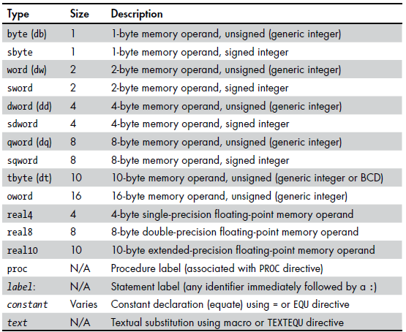
Memory & Datatypes
Signed datatypes: use signed bits to indicate whether a number is positive or negative.
Unsigned datatypes: can only represent positive numbers but have an integer maximum that is twice the maximum of signed datatypes.
RealX: used for floating (decimal) numbers, the more precision the bigger the decimal
Table 1-4: MASM Data Types

Slide 11
Memory & Storage
Memory (RAM) stores data such as variables & constants
X86-64 supports byte-addressable memory, meaning the basic memory unit is 1 byte (8 bits)
To store values larger than a byte, x86 utilizes consecutive locations in memory; making note of the lowest address
Like C, MASM will handle which memory addresses each variable & constant is stored in
Figure 1-5: Byte, word, and double-word storage in memory

Slide 12
Basic Syntax
Pg 18 - 23

Slide 13
Basic Syntax
Memory (RAM) stores data such as variables & constants
X86-64 supports byte-addressable memory, meaning the basic memory unit is 1 byte (8 bits)
To store values larger than a byte, x86 utilizes consecutive locations in memory; making note of the lowest address
Like C, MASM will handle which memory addresses each variable & constant is stored in
Figure 1-5: Byte, word, and double-word storage in memory

Slide 14
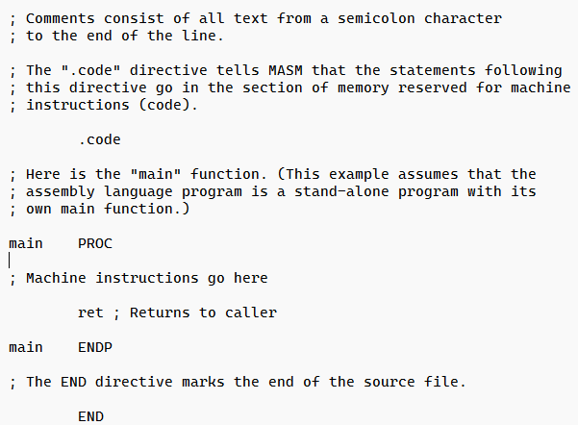
Anatomy of *.asm
Listing 1-1: Trivial shell program (pg. 5)

Slide 15
Figure 2-1: Bit numbering

Slide 16
Figure 2-2: The two nibbles in a byte

Slide 17
Figure 2-3: Bit numbers in a word

Slide 18
Figure 2-4: The two bytes in a word

Slide 19
Figure 2-5: The four nibbles in a word

Slide 20
Figure 2-6: Bit numbers in a double word

Slide 21
Figure 2-7: Nibbles, bytes, and words in a double-word

Slide 22
Figure 2-8: Shift left operation

Slide 23
Figure 2-9: shl by 1 operation

Slide 24
Figure 2-10: Shift right operation

Slide 25
Figure 2-11: shr by 1 operation

Slide 26
Figure 2-12: Arithmetic shift right operation

Slide 27
Figure 2-13: sar dest, 1 operation

Slide 28
Figure 2-14: Rotate left and rotate right operations

Slide 29
Figure 2-15: ror dest, 1 operation

Slide 30
Figure 2-16: ror dest, 1 operation

Slide 31
Figure 2-17: rcl dest, 1 and rcr dest, 1 operations

Slide 32
Figure 2-18: Short packed data format (two bytes)

Slide 33
Figure 2-19: Long packed date format (four bytes)

Slide 34
Figure 2-20: FLAGS register as packed Boolean data

Slide 35
Figure 2-21: Single-precision (32-bit) floating-point format

Slide 36
Figure 2-22: 64-bit double-precision floating-point format

Slide 37
Figure 2-23: 80-bit extended-precision floating-point format

Slide 38
Figure 2-24: BCD data representation in memory

Slide 39
Figure 2-25: ASCII codes for E and e

Slide 40
Figure 2-26: Surrogate code point encoding for Unicode planes 1 to 16

Slide 41
Figure 3-1: MASM typical runtime memory organization

Slide 42
Figure 3-2: Word access at the end of an MMU page

Slide 43
Figure 3-3: Address and data bus for 16-bit processors

Slide 44
Figure 3-4: Reading a byte from an even address on a 16-bit CPU

Slide 45
Figure 3-5: Reading a byte from an odd address on a 16-bit CPU

Slide 46
Figure 3-6: Accessing a word on a 32-bit CPU

Slide 47
Figure 3-7: PC-relative addressing mode

Slide 48
Figure 3-8: Accessing a word or dword by using the PC-relative addressing mode

Slide 49
Figure 3-9: Indirect-plus-offset addressing mode

Slide 50
Figure 3-10: Scaled-indexed addressing mode

Slide 51
Figure 3-11: Small address form of indirect-plus-offset addressing mode

Slide 52
Figure 3-12: Small address form of indirect-plus-offset-plus-constant addressing mode

Slide 53
Figure 3-13: Small address form of base-plus-scaled-indexed addressing mode

Slide 54
Figure 3-14: Small address form of base-plus-scaled-indexed-plus-constant addressing mode

Slide 55
Figure 3-15: Small address form of scaled-indexed addressing mode

Slide 56
Figure 3-16: Small address form of scaled-indexed-plus-constant addressing mode

Slide 57
Figure 3-17: Using an address expression to access data beyond a variable

Slide 58
Figure 3-18: Stack segment before the push rax operation

Slide 59
Figure 3-19: Stack segment after the push rax operation

Slide 60
Figure 3-20: Memory before a pop rax operation

Slide 61
Figure 3-21: Memory after the pop rax instruction

Slide 62
Figure 3-22: Stack after pushing RAX

Slide 63
Figure 3-23: Stack after pushing RBX

Slide 64
Figure 3-24: Stack after popping RAX

Slide 65
Figure 3-25: Stack after popping RBX

Slide 66
Figure 3-26:Removing data from the stack, before add rsp, 16

Slide 67
Figure 3-27: Removing data from the stack, after add rsp, 16

Slide 68
Figure 3-28: Stack after pushing RAX and RBX

Slide 69
Figure 4-1: Array layout in memory

Slide 70
Figure 4-2: Mapping a 4×4 array to sequential memory locations

Slide 71
Figure 4-3: Row-major array element ordering

Slide 72
Figure 4-4: Another view of row-major ordering for a 4×4 array

Slide 73
Figure 4-5: Viewing a 4×4 array as an array of arrays

Slide 74
Figure 4-6: Column-major array element ordering

Slide 75
Figure 4-7: Student data structure storage in memory

Slide 76
Figure 4-8: Layout of a union versus a structure variable

Slide 77
Figure 5-1: Stack contents before ret in the MessedUp procedure

Slide 78
Figure 5-2: Stack contents before ret in messedUp2

Slide 79
Figure 5-3: Stack organization immediately upon entry into ARDemo

Slide 80
Figure 5-4: Activation record for ARDemo

Slide 81
Figure 5-5: Offsets of objects in the ARDemo activation record

Slide 82
Figure 5-6: Activation record for the LocalVars procedure

Slide 83
Figure 5-7: Stack layout upon entry into CallProc

Slide 84
Figure 5-8: Activation record for CallProc after standard entry sequence execution

Slide 85
Figure 6-1: A floating-point format

Slide 86
Figure 6-2: FPU floating-point register stack

Slide 87
Figure 6-3: FPU control register

Slide 88
Figure 6-4: The FPU status register

Slide 89
Figure 6-5: Floating-point formats

Slide 90
Figure 6-6: FPU integer formats

Slide 91
Figure 6-7: FPU packed decimal format

Slide 92
Figure 7-1: if/then/else/endif and if/then/endif statement flow

Slide 93
Figure 7-2: Continue destination for the for(;;) loop

Slide 94
Figure 7-3: Continue destination for the while loop

Slide 95
Figure 7-4: Continue destination for the for loop

Slide 96
Figure 7-5: Continue destination for the repeat..until loop

Slide 97
Figure 8-1: Multi-digit addition

Slide 98
Figure 8-2: Adding two 192-bit objects together

Slide 99
Figure 8-3: Multi-digit multiplication

Slide 100
Figure 8-4: Extended-precision multiplication

Slide 101
Figure 8-5: Manual digit-by-digit division

Slide 102
Figure 8-6: Longhand division in binary

Slide 103
Figure 8-7: 128-bit shift left operation

Slide 104
Figure 8-8: shld operation

Slide 105
Figure 8-9: shrd operation

Slide 106
Figure 11-1: Packed and scalar single-precision floating-point data type

Slide 107
Figure 11-2: Packed and scalar double-precision floating-point type

Slide 108
Figure 11-3: Packed byte data type

Slide 109
Figure 11-4: Packed word data type

Slide 110
Figure 11-5: Packed double-word data type

Slide 111
Figure 11-6: Packed quad-word data type

Slide 112
Figure 11-7: Moving a 32-bit value from memory to an XMM register (with zero extension)

Slide 113
Figure 11-8: Moving a 64-bit value from memory to an XMM register (with zero extension)

Slide 114
Figure 11-9: movlps instruction

Slide 115
Figure 11-10: vmovlps instruction

Slide 116
Figure 11-11: movhps instruction

Slide 117
Figure 11-12: movhpd instruction

Slide 118
Figure 11-13: vmovhpd and vmovhps instructions

Slide 119
Figure 11-14: movshdup and vmovshdup instructions

Slide 120
Figure 11-15: movsldup and vmovsldup instructions

Slide 121
Figure 11-16: movddup instruction behavior

Slide 122
Figure 11-17: vmovddup instruction behavior

Slide 123
Figure 11-18: Register aliasing at the microarchitectural level

Slide 124
Figure 11-19: Lane index correspondence for pshufb instruction

Slide 125
Figure 11-20: phsufb byte index

Slide 126
Figure 11-21: Shuffle operation

Slide 127
Figure 11-22: (v)pshuflw xmm, xmm/mem, imm8 operation

Slide 128
Figure 11-23: vpshuflw ymm, ymm/mem, imm8 operation

Slide 129
Figure 11-24: (v)pshufhw operation

Slide 130
Figure 11-25: vpshufhw operation

Slide 131
Figure 11-26: shufps operation

Slide 132
Figure 11-27: shufpd operation

Slide 133
Figure 11-28: unpcklps instruction operation

Slide 134
Figure 11-29: unpckhps instruction operation

Slide 135
Figure 11-30: unpcklpd instruction operation

Slide 136
Figure 11-31: unpckhpd instruction operation

Slide 137
Figure 11-32: vunpcklps instruction operation

Slide 138
Figure 11-33: vunpckhps instruction operation

Slide 139
Figure 11-34: punpcklbw instruction operation

Slide 140
Figure 11-35: punpckhbw operation

Slide 141
Figure 11-36: punpcklwd operation

Slide 142
Figure 11-37: punpckhwd operation

Slide 143
Figure 11-38 punpckldq operation

Slide 144
Figure 11-39: punpckhdq operation

Slide 145
Figure 11-40: punpcklqdq operation

Slide 146
Figure 11-41: punpckhqdq operation

Slide 147
Figure 11-42: SIMD concurrent arithmetic and logical operations

Slide 148
Figure 11-43: Horizontal addition operation

Slide 149
Figure 11-44: Merging bits from pcmpeqw

Slide 150
Figure 11-45: movmskps operation

Slide 151
Figure 11-46: movmskpd operation

Slide 152
Figure 11-47: vmovmskps operation

Slide 153
Figure 11-48: vmovmskpd operation

Slide 154
Figure 12-1: Isolating a bit string by using the and instruction

Slide 155
Figure 12-2: Inserting bits 0 to 12 of EAX into bits 12 to 24 of EBX

Slide 156
Figure 12-3: Inserting a bit string into a destination operand

Slide 157
Figure 12-4: Bit mask for pext instruction

Slide 158
Figure 12-5: pdep instruction operation

Slide 159
Figure 13-1: Compile-time versus runtime execution

Slide 160
Figure 13-2: Operation of a MASM compile-time if statement

Slide 161
Figure 13-3: MASM compile-time while statement operation

Slide 162
Figure 14-1: Copying data between two overlapping arrays (forward direction)

Slide 163
Figure 14-2: Using a backward copy to copy data in overlapping arrays

Slide 164
Figure 14-3: Equal each aggregate comparison operation

Slide 165
Figure 16-1: Sample dialog box output

